Slide 1
Heuristic evaluation of Yale school of art Website
Shivani Dhar
Aishwarya Kasthala
Group 3
Eric Agyemang
Kelvin Ongaga
Jahnavi Chintalacheruvu
https://www.art.yale.edu/

Slide 2

Introduction
Project Evaluates Yale school of Art’s website
The website gives information about the College of Arts:
Home page- Community bulletin, board, calendar of events , and quick links.
News page- Newsletters, archives, and celebration of Alums.
Publication page -MFA book series, archives, and commitments.
Apply page - Apply, admissions, tuition & fees, housing, and brochures.
About the School- Mission, diversity, people, and lectures.

Slide 3
Pages to be reviewed
Home page: https://www.art.yale.edu/
News page: https://www.art.yale.edu/news
Publications page: https://www.art.yale.edu/publications
Apply to school: https://www.art.yale.edu/apply
About the school: https://www.art.yale.edu/about

Slide 4
Aggregated Heuristics EVALUATIONS by our team after careful review and discussion

Slide 5
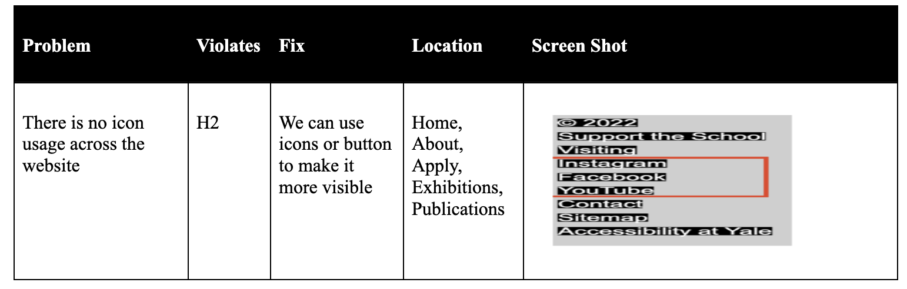
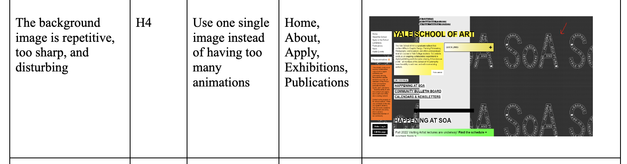

Slide 6
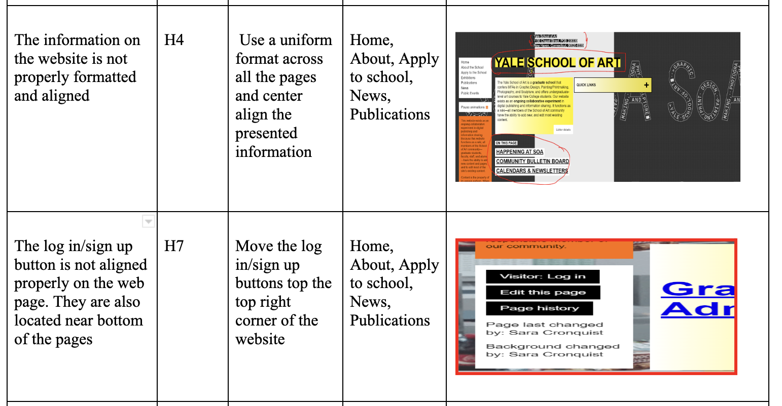

Slide 7
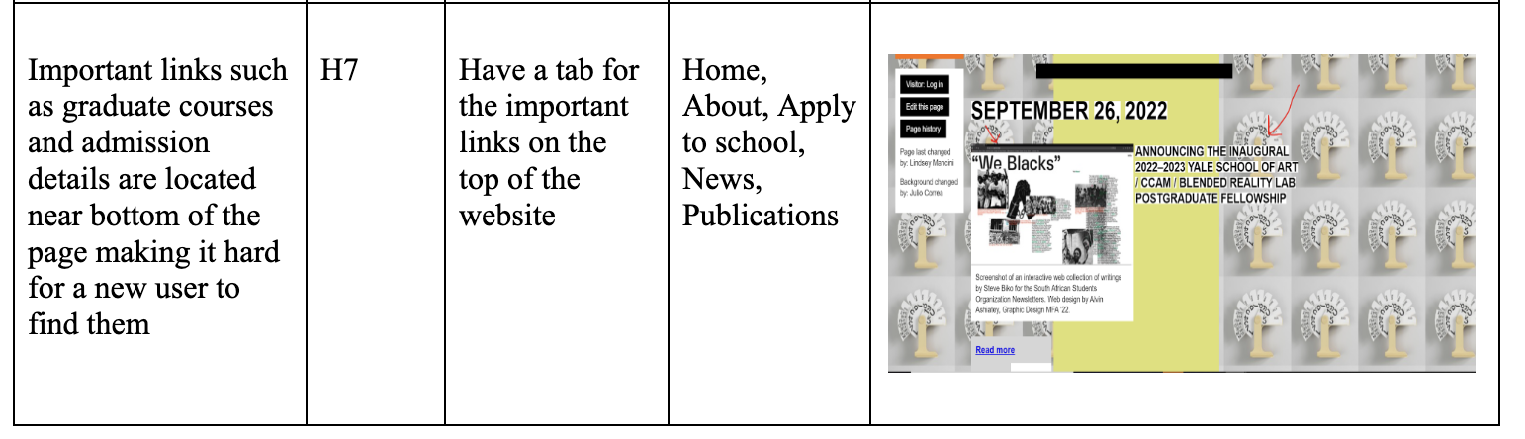
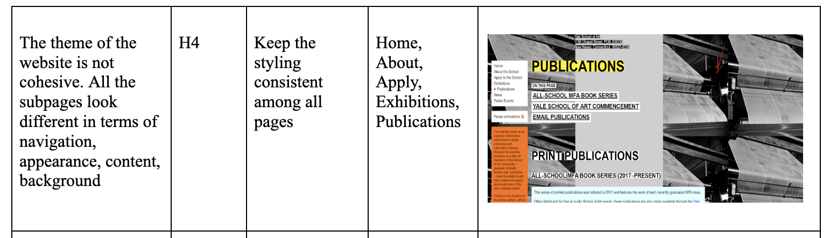

Slide 8
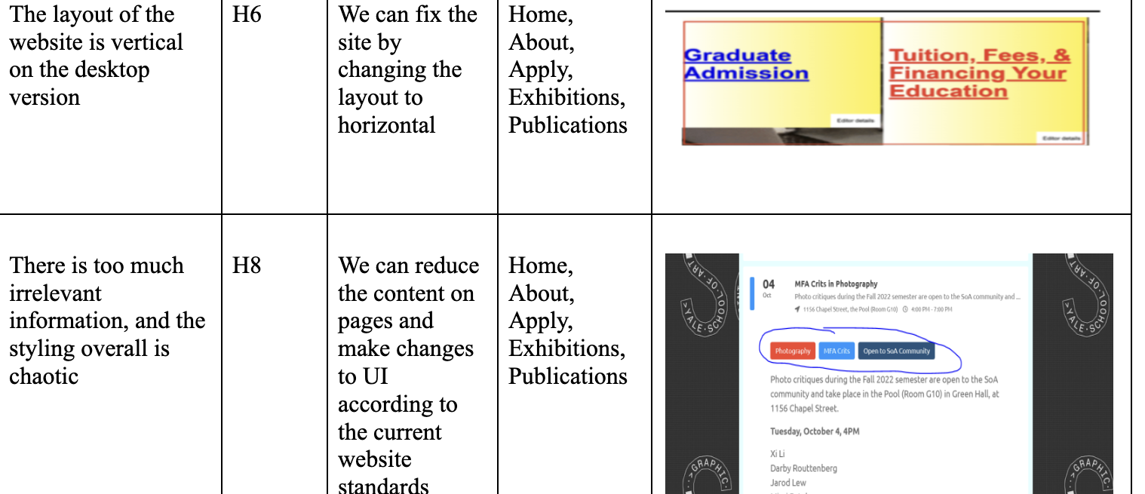

Slide 9

Average heuristic severity ratings
Aggregated rATINGs
FROM ALL EVALUATORS

Slide 10
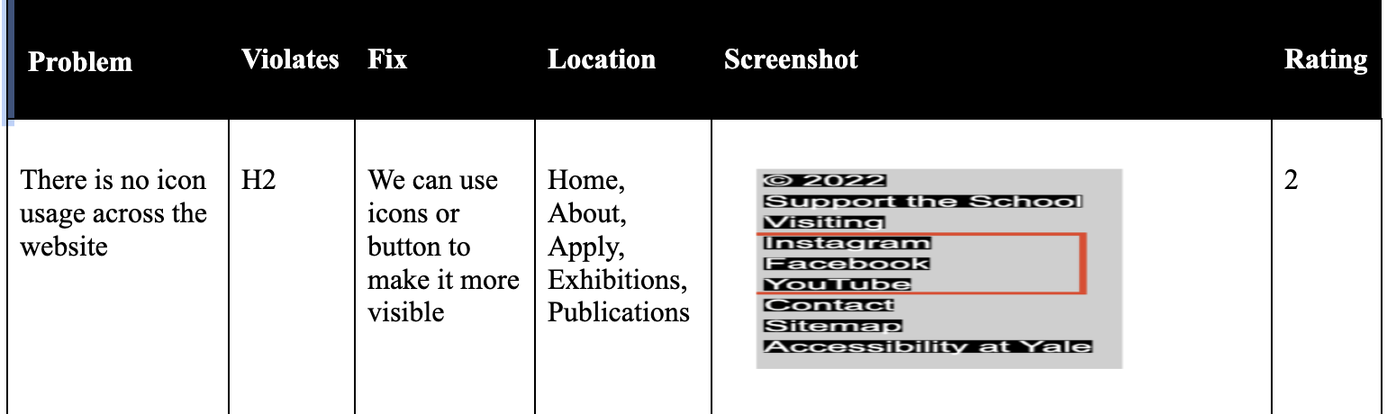
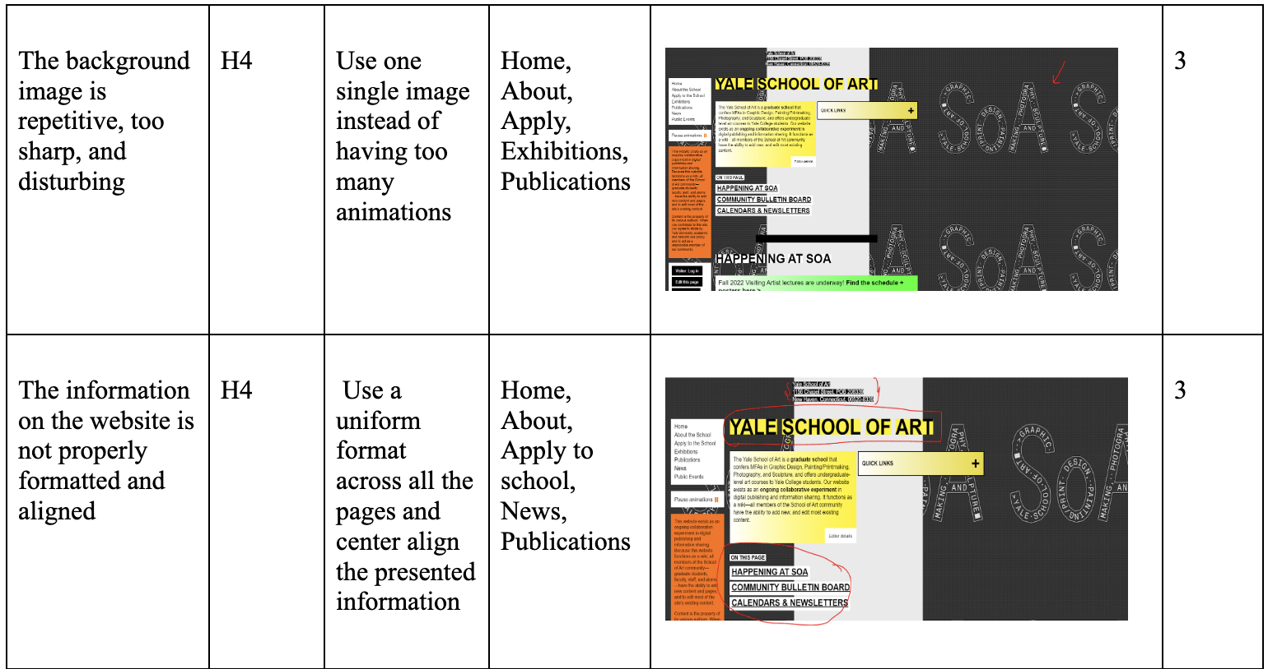

Slide 11
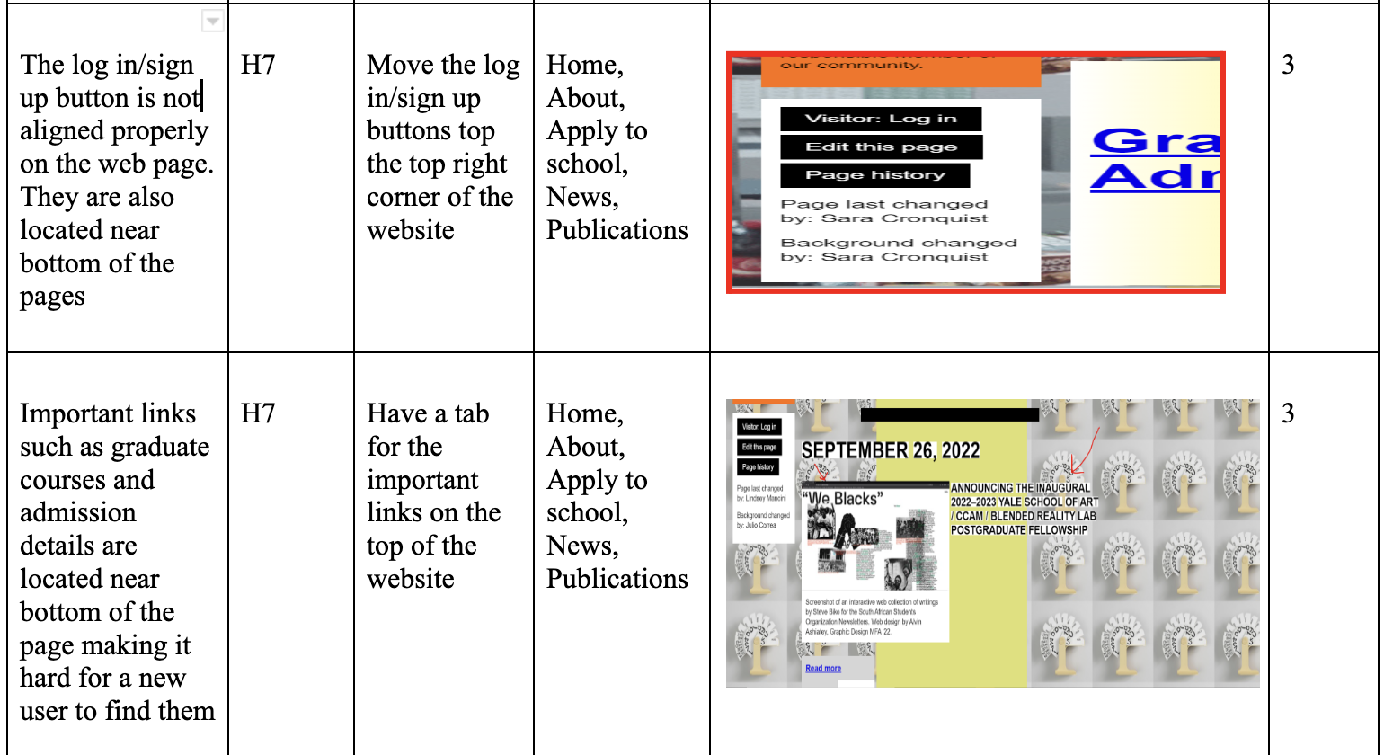

Slide 12
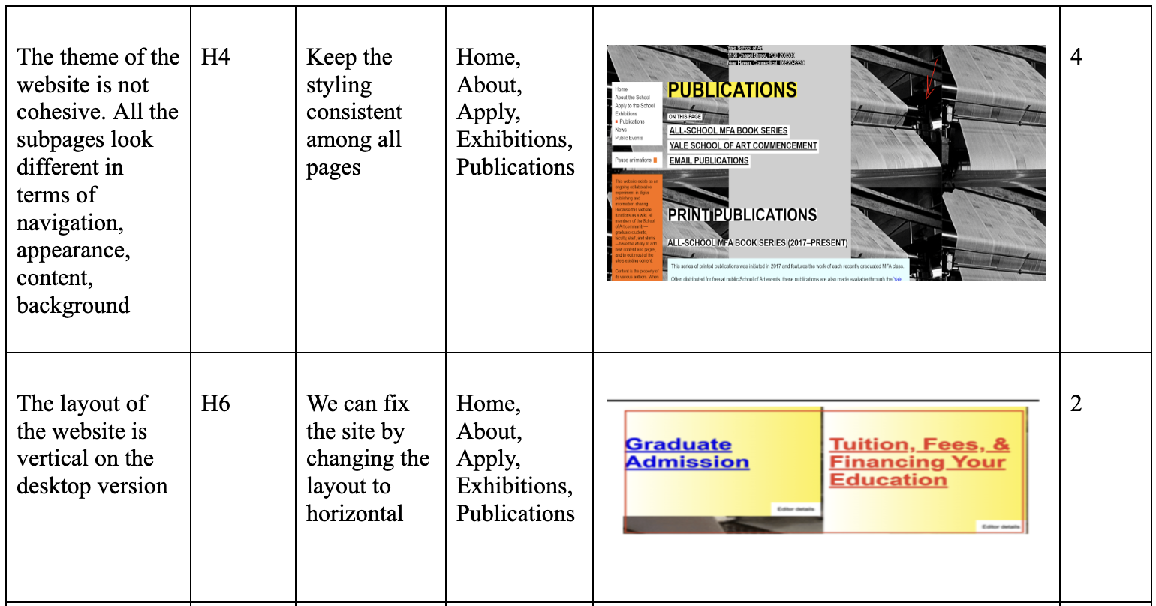
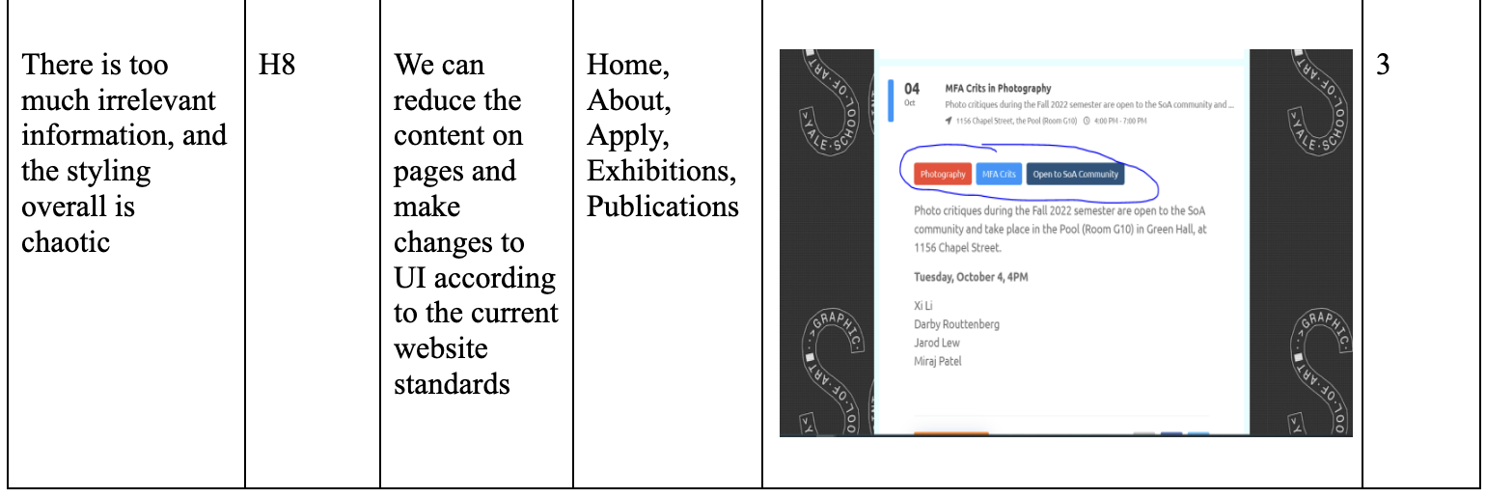

Slide 13
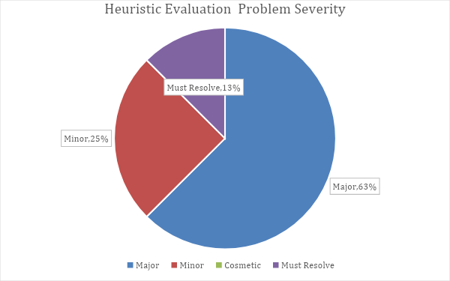
Overall Heuristic evaluation statistics

Slide 14
Thank you!!

